Slide 1
Machine Learning with Python
Jacalyn Huband Computational Research Support Specialist E: jmh5ad@virginia.edu
9 June 2022
Alois D’Uston Computational Support Temp E: ald6fd@virginia.edu
Gladys Andino Senior Computational Scientist E: gka6a@virginia.edu

Slide 2
Topics
Overview of Machine Learning
Decision Trees
Random Forest
>> Break <<
Overview of Neural Networks
Tensorflow/Keras
PyTorch
>> Break <<
Overview of Parallelizing Deep Learning

Slide 3
What is machine learning?
A branch of artificial intelligence where computers learn from data, and adapt the computational models to enhance performance.
A method of analysis that allows computers to reveal information within data.

Slide 4
What is machine learning?
The “learning” is not the type of learning that you and I do.
It is a systematic approach to finding an appropriate data transformation from inputs to output.

Slide 5
Why machine learning?
Computers can sort through data faster than humans can.
Computers can identify patterns quickly and use these patterns for predictions or classifications.
Machine learning can handle noisy data – it doesn’t find a perfect answer, but rather a “really good” answer.

Slide 6
Problems that ML can solve
Regression techniques
Determines a mathematical model for the relationship among features or attributes so that an outcome can be predicted.
Results can be any value within a possible range (e.g., what will the average Earth temperature be in 2050?)
Classification problem
Identifies a combination of attributes that best fits a class or category so that an object can be classified.
Results can be from a list of known possibilities (e.g., is the tumor benign or malignant?)

Slide 7
Problems that ML can solve
Regression techniques
Determines a mathematical model for the relationship among features or attributes so that an outcome can be predicted.
Results can be any value within a possible range (e.g., what will the average Earth temperature be in 2050?)
Classification problem
Identifies a combination of attributes that best fits a class or category so that an object can be classified.
Results can be from a list of known possibilities (e.g., is the tumor benign or malignant?)

Slide 8
Types of Machine Learning. . .
Supervised Learning:
A data set exists where the samples can be categorized into two or more classifications.
The computer uses the data set to learn how to predict the classification of an unknown sample.
Examples include Decision Trees and Deep Learning
Unsupervised Learning:
The collected data has no known classification or pattern.
The computer must identify the groups or hidden structures within the data.
Examples include Dendograms, K-means clustering, Self-organizing Maps
Reinforcement Learning:
Computer learns from positive or negative feedback
Example includes Swarm intelligence

Slide 9
Types of Machine Learning. . .
Supervised Learning:
A data set exists where the samples can be categorized into two or more classifications.
The computer uses the data set to learn how to predict the classification of an unknown sample.
Examples include Decision Trees and Deep Learning
Unsupervised Learning:
The collected data has no know classification or pattern.
The computer must identify the groups or hidden structures within the data.
Examples include Dendograms, K-means clustering, Self-organizing Maps
Reinforcement Learning:
Computer learns from positive or negative feedback
Example includes Swarm intelligence

Slide 10
Data for Machine Learning
For many Machine Learning algorithms, the data are expected to be in a table format, where:
each row represents an object, and
each column has the measurements for a specific attribute or feature of the object
For supervised learning, the classifications of the objects must be known.
The data with known classifications are divided into a training set and a testing set.
The data are used to develop a model.
The training data are submitted to an algorithm that will fit a model to the data.
The test data are submitted to the model to produce predicted classifications and determine the accuracy of the model.
Finally, the model can be used to predict classifications for “unknown” data.

Slide 11
Ideas behind Machine Learning
The algorithm determines the best mathematical model for the code
However, you still need to provide a “framework” for the algorithm.
The framework provides the algorithm with tools for performing the learning
Data Measurements
Machine Learning Algorithm
Model defining the relationship between the input and the output
Label or Classification

Slide 12
Decision Trees

Slide 13
Decision Tree: Overview
A classification algorithm within supervised learning.
The algorithm determines a set of questions or tests that will guide it toward a classification of an observation.
It organizes a series of attribute tests into a tree-structure to help determine classification of the unlabeled data.
Motivating Question:
Given a set of data, can we determine which attributes should be tested first to predict a category or outcome (i.e., which attributes lead to “high information gain”) ?

Slide 14
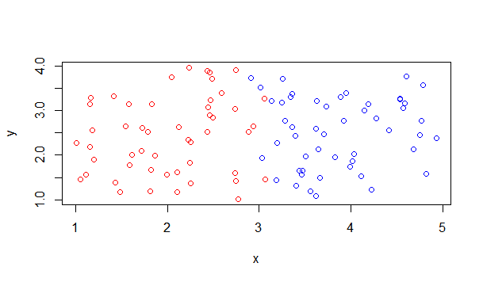
Decision Trees: How do they work?
Suppose we have
a group of people, each one with a tumor, and
two measurements (x, y) for each tumor.
Plotting the data, and coloring the points red for malignant tumors and blue for benign tumors, we might see a plot as follows:
Clearly, something happens near x = 3

Slide 15
Decision Trees: How do they work?
With very few errors, we can use x=3 as our “decision” to categorize the tumor as malignant vs. benign
Resulting decision tree:
Unfortunately, it is not always this easy, especially if we have much more complex data. More layers of questions can be added with more attributes.
x < 3
Yes
No
Malignant
Benign

Slide 16
Example: What should you do this weekend?
Weather | Parents Visiting | Have extra cash | Weekend Activity
Sunny | Yes | Yes | Cinema
Sunny | No | Yes | Tennis
Windy | Yes | Yes | Cinema
Rainy | Yes | No | Cinema
Rainy | No | Yes | Stay In
Rainy | Yes | No | Cinema
Windy | No | No | Cinema
Windy | No | Yes | Shopping
Windy | Yes | Yes | Cinema
Sunny | No | Yes | Tennis

Slide 17
What to do this weekend?
Can the tree be more efficient?.
Weather
Sunny
Windy
Rainy
Parents Visiting
Parents Visiting
Parents Visiting
Yes
No
Yes
No
Yes
No
Cinema
Tennis
Cinema
Cash
Cinema
Stay In
Yes
No
Shop
Cinema

Slide 18
What to do this weekend?
Parents Visiting
Yes
No
Cinema
Weather
Sunny
Windy
Rainy
Tennis
Cash
Stay In
Also with complex data, it is possible that not all features are needed in the Decision Tree.
Yes
No
Shop
Cinema

Slide 19
Decision Tree Algorithms
There are many existing Decision Tree algorithms.
If written correctly, the algorithm will determine the best question/test for the tree.
How do we know how accurate our decision tree is?

Slide 20
Decision Tree Evaluation
A confusion matrix is often used to show how well the model matched the actual classifications.
The matrix is not confusing – it simply illustrates how “confused” the model is!
It is generated based on test data.
 |  | Predicted Classification
 |  | Cinema | Shop | Stay In | Tennis
Actual Classification | Cinema | 95 | 20 | 2 | 3
 | Shop | 3 | 7 | 1 | 1
 | Stay In | 2 | 0 | 5 | 0
 | Tennis | 36 | 8 | 4 | 73

Slide 21
Coding a Decision Tree

Slide 22
The Data
For our first example, we will be using a set of measurements taken on various red wines.
The data set is from
P. Cortez, A. Cerdeira, F. Almeida, T. Matos and J. Reis. Modeling wine preferences by data mining from physicochemical properties. In Decision Support Systems, Elsevier, 47(4):547-553, 2009.
The data are located at
https://archive.ics.uci.edu/ml/machine-learning-databases/wine-quality/winequality-red.csv
There are 12 measurements, taken on 1599 different red wines.

Slide 23
Attribute Summary
Data columns (total 12 columns):
fixed acidity 1599 non-null float64
volatile acidity 1599 non-null float64
citric acid 1599 non-null float64
residual sugar 1599 non-null float64
chlorides 1599 non-null float64
free sulfur dioxide 1599 non-null float64
total sulfur dioxide 1599 non-null float64
density 1599 non-null float64
pH 1599 non-null float64
sulphates 1599 non-null float64
alcohol 1599 non-null float64
quality 1599 non-null int64
dtypes: float64(11), int64(1)
memory usage: 150.0 KB
Question: Can we predict the quality of the wine from the attributes?

Slide 24
Coding Decision Trees: General Steps
Load the decision tree packages
Read in the data
Identify the target feature
Divide the data into a training set and a test set.
Fit the decision tree model
Apply the model to the test data
Display the confusion matrix

Slide 25
1. Load Decision Tree Package
from sklearn import tree

Slide 26
2. Read in the data
import pandas as pd
data_url = "https://archive.ics.uci.edu/ml/machine-learning-databases/wine-quality/winequality-red.csv"
wine = pd.read_csv(data_url, delimiter=';')
print(wine.info())

Slide 27
3. Identify the target feature
#Split the quality column out of the data
wine_target = wine['quality']
wine_data = wine.drop('quality', axis=1)
For the functions that we will be using, the target values (e.g., quality) must be a separate object.

Slide 28
4. Divide the Data
from sklearn import model_selection
test_size = 0.30
seed = 7
train_data, test_data, train_target, test_target = model_selection.train_test_split(wine_data,
wine_target, test_size=test_size,
random_state=seed)

Slide 29
5. Fit the Decision Tree Model
model = tree.DecisionTreeClassifier()
model = model.fit(train_data, train_target)

Slide 30
6. Apply the Model to the Test Data
prediction = model.predict(test_data)

Slide 31
7. Display Confusion Matrix
row_name ="Quality"
cm = pd.crosstab(test_target, prediction,
rownames=[row_name], colnames=[''])
print(' '*(len(row_name)+3),"Predicted ", row_name)
print(cm)

Slide 32
Activity: Decision Tree Program
Make sure that you can run the decisionTree code:
Python
01_Decision_Tree.ipynb

Slide 33
Random Forest

Slide 34
Random Forest: Overview
A classification algorithm within supervised learning.
An Ensemble Technique –
These techniques combine a group of “weaker” learning techniques to build a stronger technique.
Random Forest combines the results of multiple decision trees to create a more robust result.

Slide 35
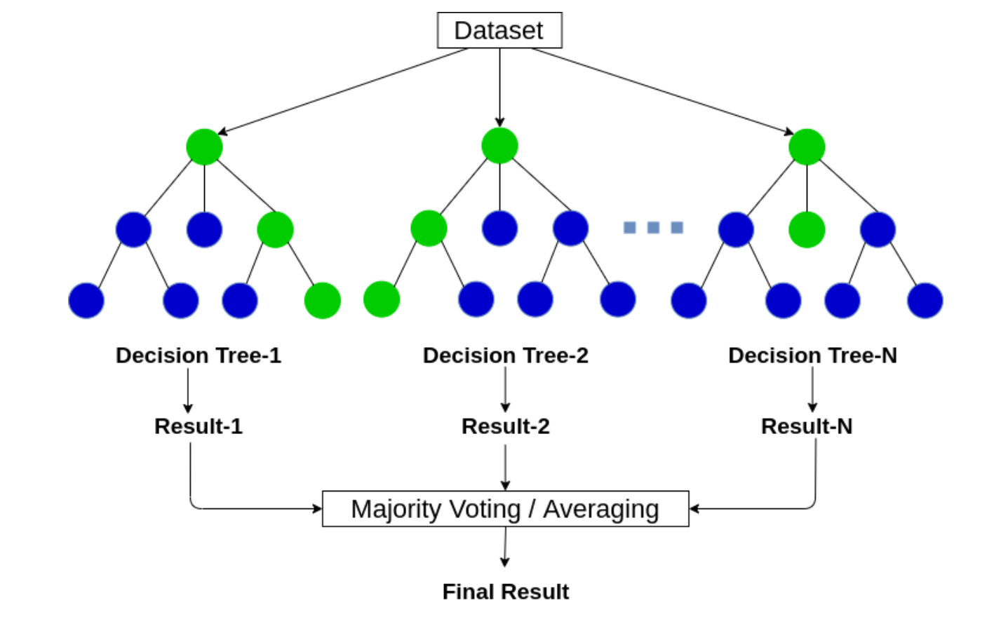
Random Forest: How does it work?
Different decision tree algorithms can produce different results.
The random forest aggregates the decisions from the trees to determine an overall solution.
Image borrowed from https://ai-pool.com/a/s/random-forests-understanding

Slide 36
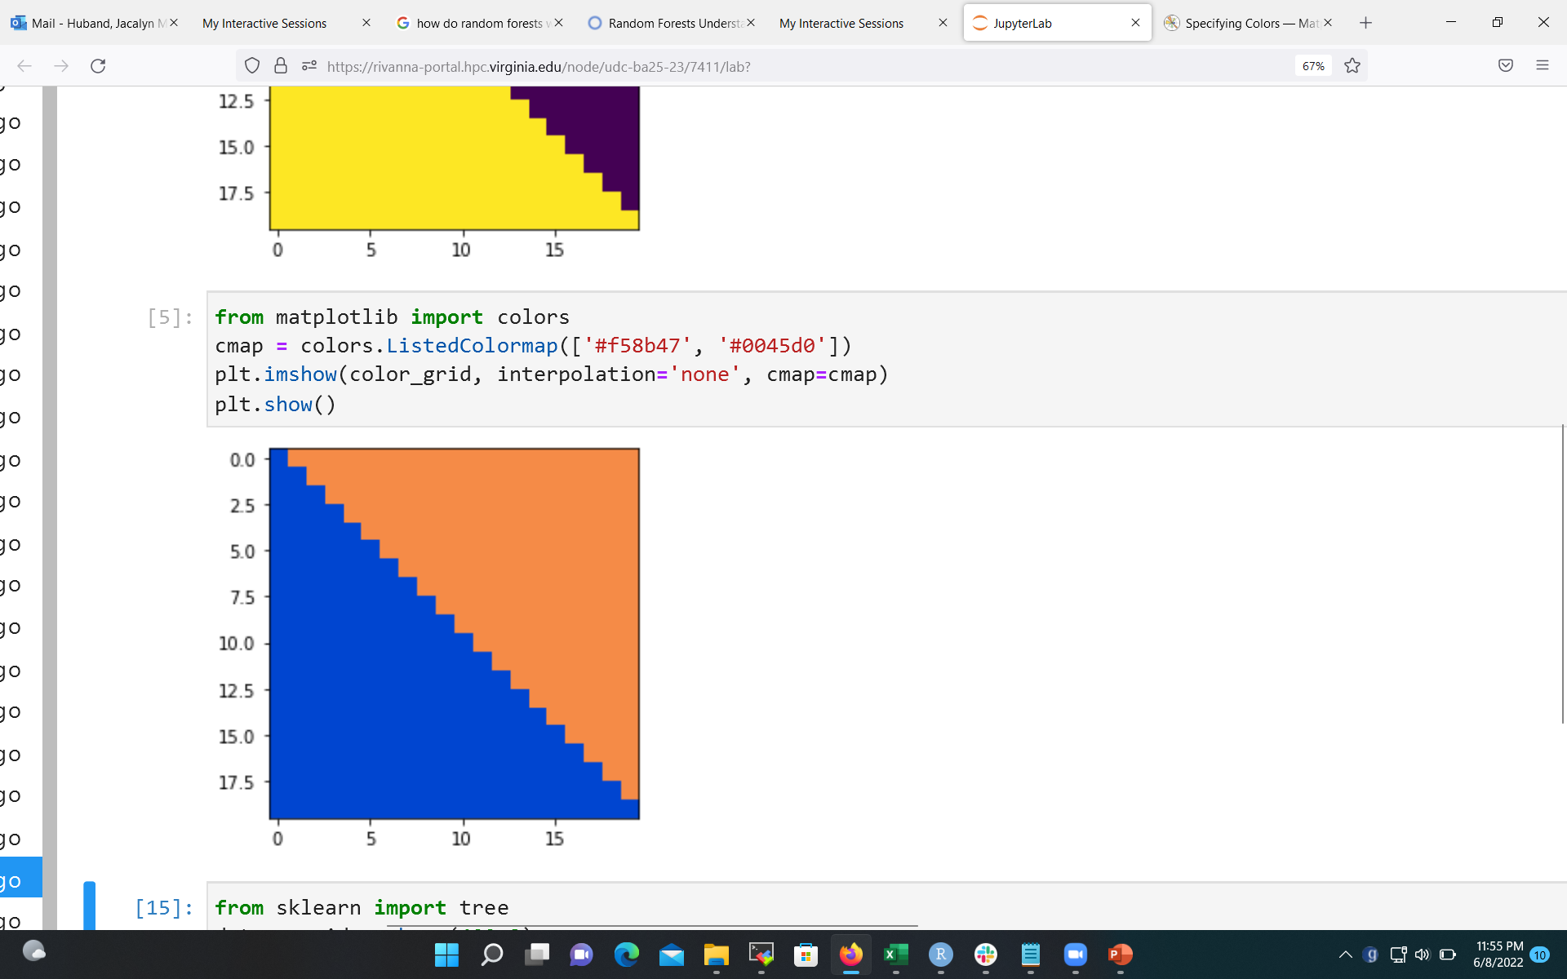
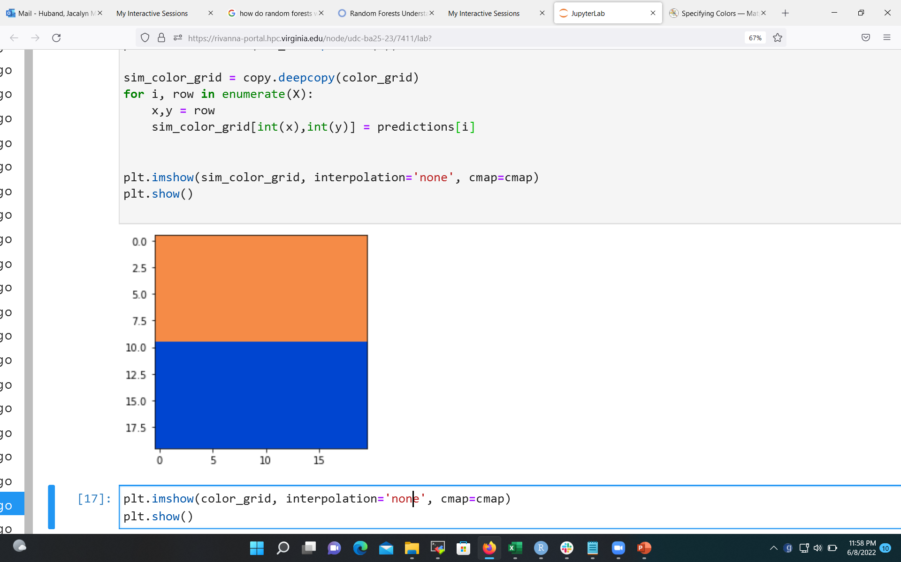
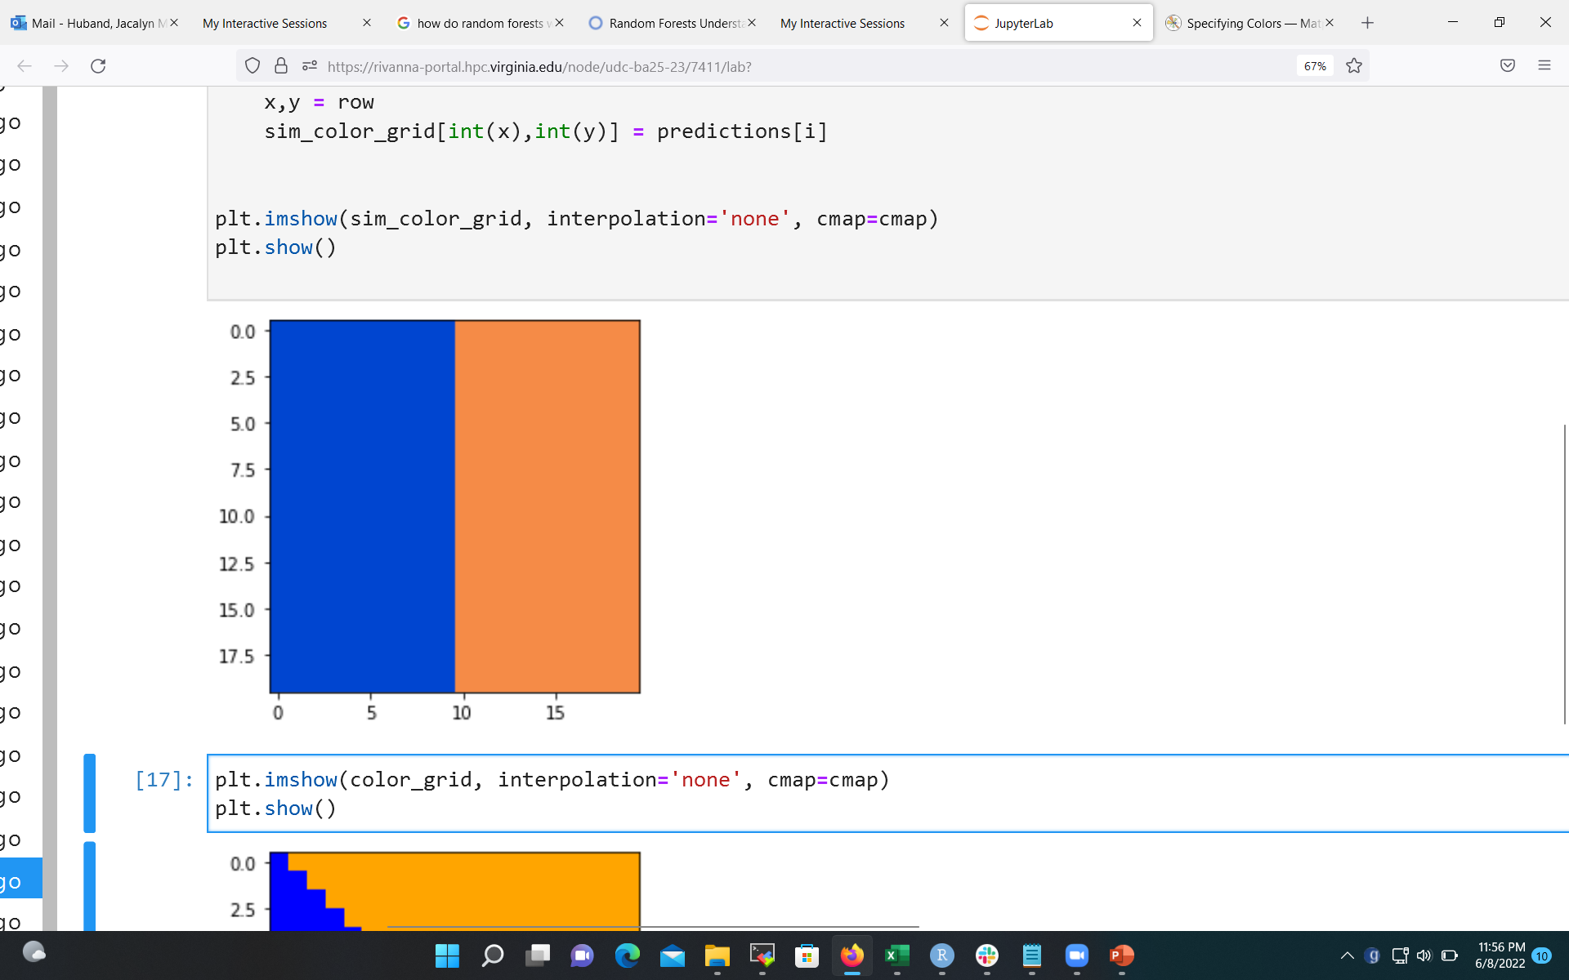
Random Forest: How does it work?
Suppose that the data fall into one of two categories (blue or orange) depending on two values, x and y, as shown in this figure:
A decision tree could choose a relationship between x, y, and the categories that matches one of the following figures:

Slide 37
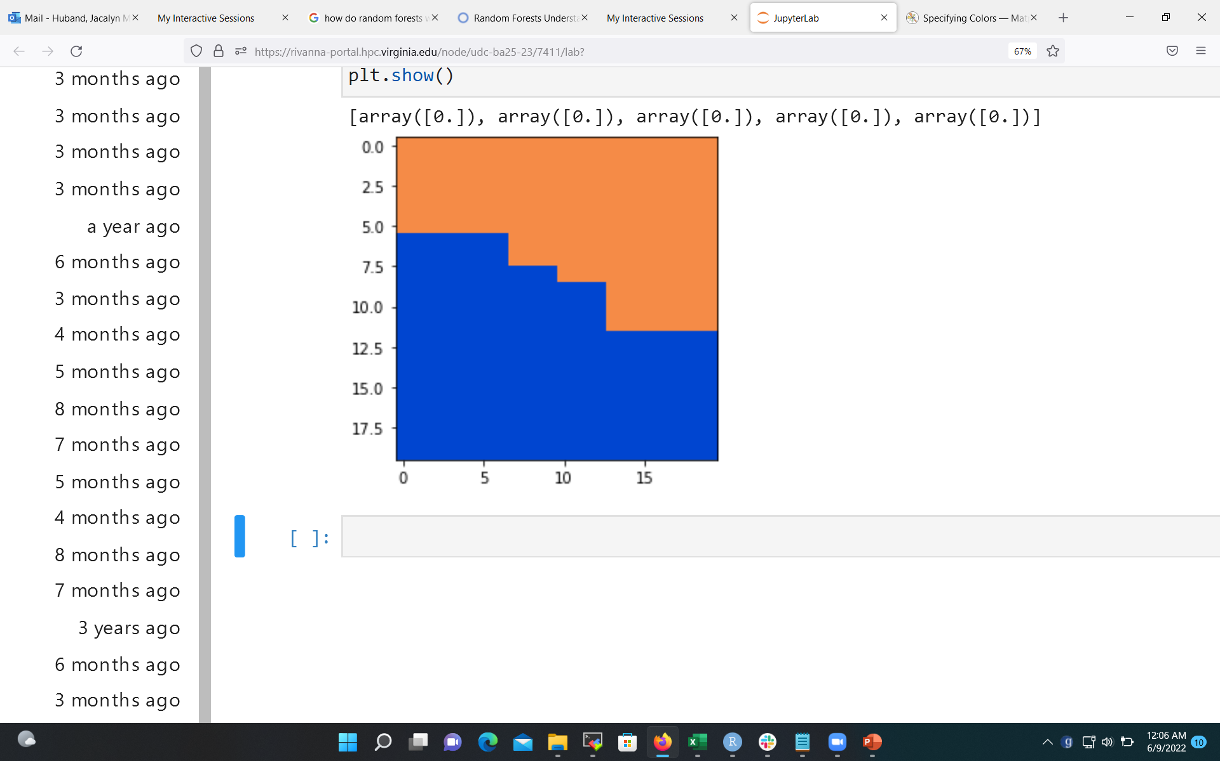
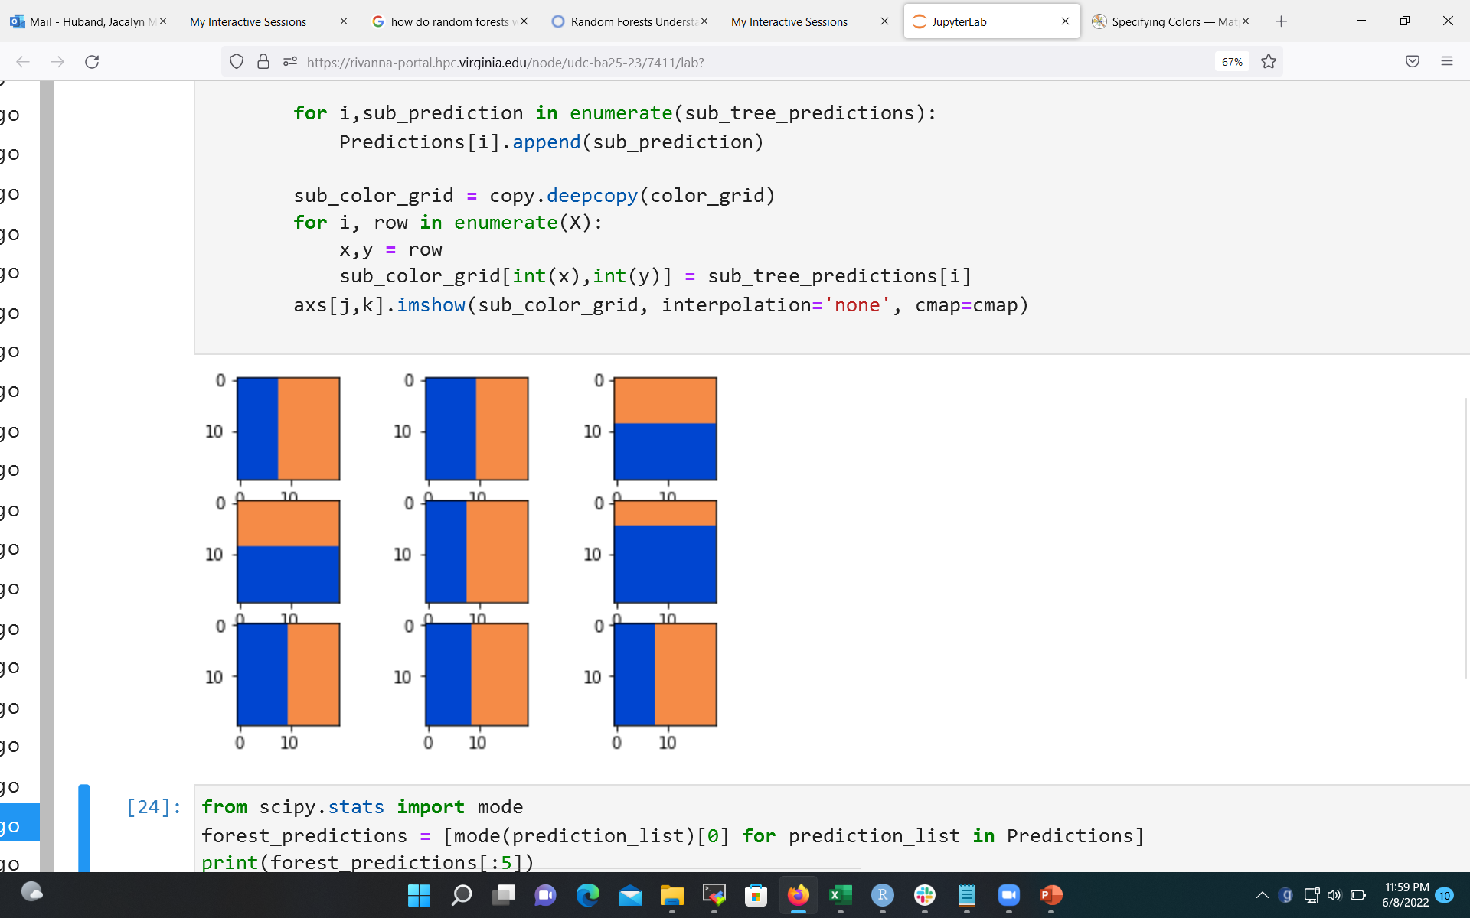
Random Forest: How does it work?
By combining the many, many outcomes, the random forest can approach the desired mapping.

Slide 38
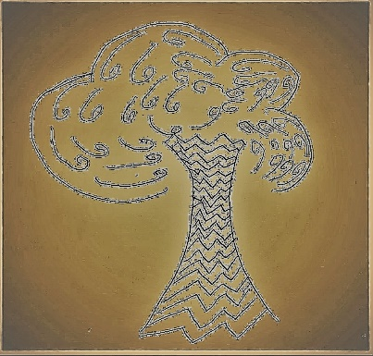



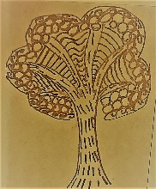

Random Forest: How does it work?
Random Forests can use different techniques for selecting features for computing each decision value.
This can lead to the choice of different features.

Slide 39
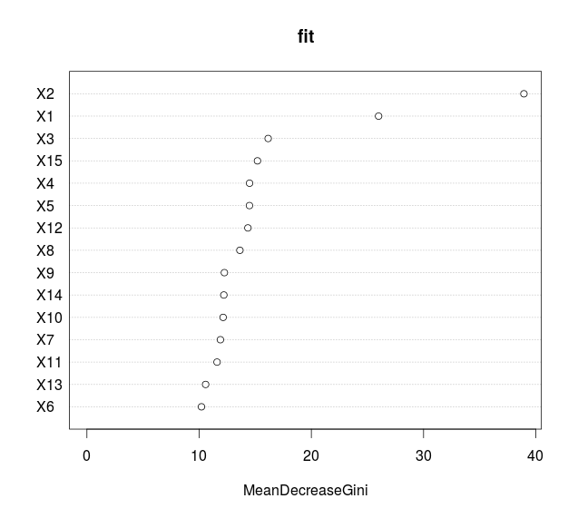
Random Forest: Feature Importance
We would like to know the “importance” of the features (e.g., which features are the most important for making decisions).
Different algorithms use various metrics to determine the importance of the features.
The value of the measurements are not as important as the order of the features.

Slide 40
Coding a Random Forest

Slide 41
The Data
For the Random Forest example, we will reuse the winequality_red data set.

Slide 42
Coding Random Forest: General Steps
Load the random forest packages
Read in the data
Identify the target feature
Divide the data into a training set and a test set.
Choose the sample size
Randomly select rows
Separate the data
Fit the random forest model
Apply the model to the test data
Display the feature importance

Slide 43
1. Load Random Forest Package
from sklearn.ensemble import RandomForestClassifier

Slide 44
Steps 2 - 4
import pandas as pd
. . .
train_data, test_data, train_target, test_target = model_selection.train_test_split(wine_data,
wine_target, test_size=test_size,
random_state=seed)
Repeat steps 2 – 4 from the Decision Tree example.

Slide 45
5. Fit the Random Forest Model
model = RandomForestClassifier()
model.fit(train_data, train_target)

Slide 46
6. Apply the Model to the Test Data
forest_results = model.predict(test_data)

Slide 47
7. Compute Feature Importance
importances = model.feature_importances_

Slide 48
8. List Feature Importance
import numpy as np
indices = np.argsort(importances)[::-1]
print("Feature ranking:")
col_names = list(train_data.columns.values)
for f in range(len(indices)):
feature = col_names[indices[f]]
space = ' '*(20 - len(feature))
print("%d.\t %s %s (%f)" % \
(f + 1, feature, space, importances[indices[f]]))

Slide 49
Activity: Random Forest Program
Make sure that you can run the Random Forest code:
Python
02_Random_Forest.ipynb

Slide 50

Break
We will return in 15 minutes.

Slide 51
Neural Networks

Slide 52
Neural Network
A computational model used in machine learning which is based on the biology of the human brain.

Slide 53
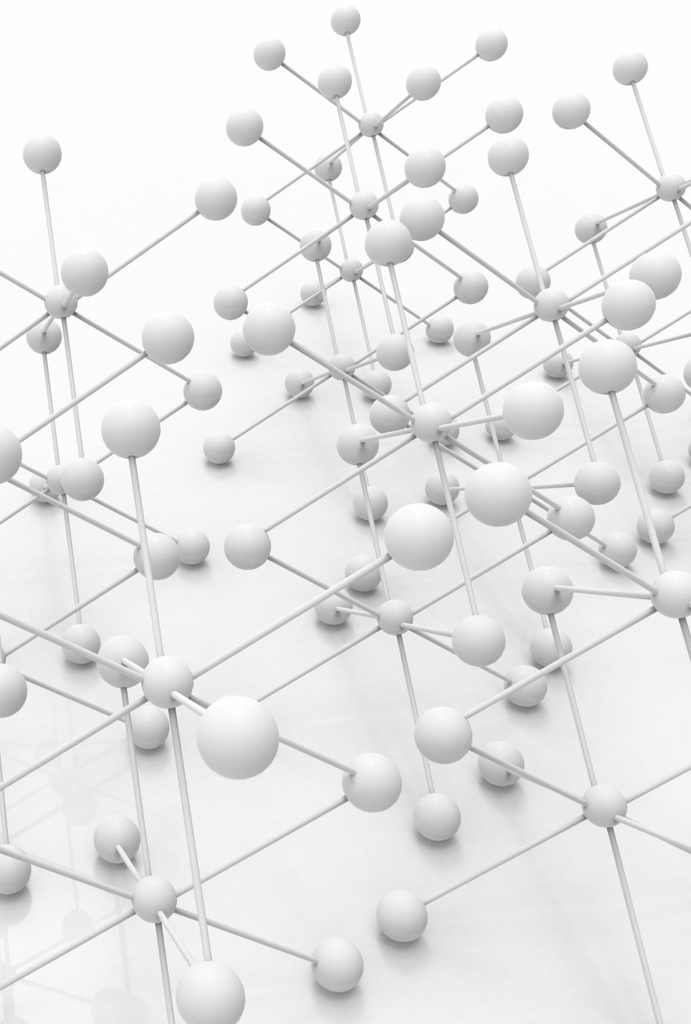
Nodes of a Neural Network
The building blocks of a neural network are neurons, also known as nodes.
Within each node is a very basic algebraic formula that transforms the data

Slide 54

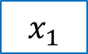

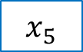
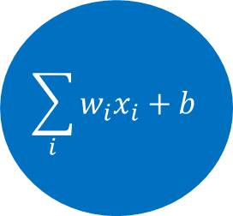





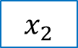
Simulation of a Neuron
The “incoming signals” would be values from a data set.
A simple computation (like a weighted sum) is performed by the “nucleus”.
Then, an “activation” function is used to determine if the output is “on” or “off”.
$$x_{1}$$
$$x_{2}$$
$$w_{1}$$
$$\sum_{i}{w_{i}x_{i}+b}$$
$$w_{2}$$
$$x_{3}$$
Activation?
$$w_{3}$$
y
$$x_{4}$$
$$w_{4}$$
$$x_{5}$$
$$w_{5}$$

Slide 55


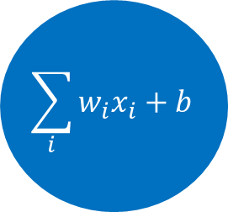


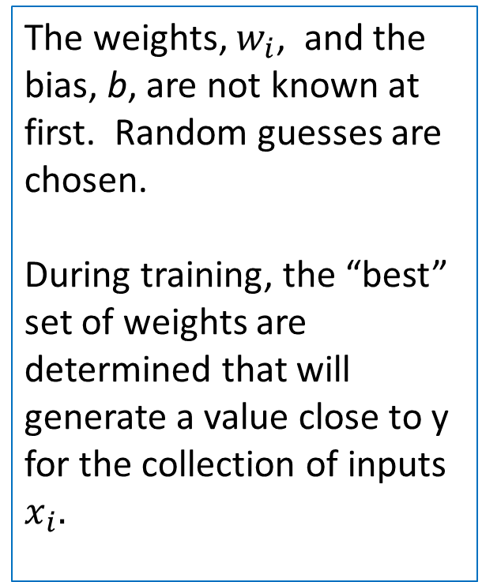






Simulation of a Neuron
The weights, $w_{i}$, and the bias, b, are not known at first. Random guesses are chosen.
During training, the “best” set of weights are determined that will generate a value close to y for the collection of inputs $x_{i}.$
$$x_{1}$$
$$x_{2}$$
$$w_{1}$$
$$\sum_{i}{w_{i}x_{i}+b}$$
$$w_{2}$$
$$x_{3}$$
Activation?
$$w_{3}$$
y
$$x_{4}$$
$$w_{4}$$
$$x_{5}$$
$$w_{5}$$

Slide 56
Network of Nodes
A single node does not provide much information (often times, a 0/1 value).
But, creating a network or layer of nodes will provide more information.

Slide 57
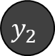
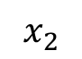

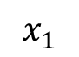
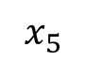
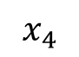
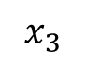
A Network of Neurons
Different computations with different weights can be performed to produce different outputs.
$$x_{1}$$
$$y_{1}$$
$$x_{2}$$
$$x_{3}$$
$$y_{2}$$
This is called a feedforward network – all values progress from the input to the output.
$$x_{4}$$
$$x_{5}$$

Slide 58
The Layers of a Network
Input
Layer
Hidden Layer
Output
Layer
A neural network has a single hidden layer
A network with two or more hidden layers is called a “deep neural network”.
$$x_{1}$$
$$y_{1}$$
$$x_{2}$$
$$x_{3}$$
$$x_{4}$$
$$y_{2}$$
$$x_{5}$$

Slide 59
How does the machine learn?
The output values or “predicted” values of the network can be compared with the expected results/categories/labels.
Start with a random guess for the weights and biases.
Another function, called a “loss” or “cost” function can be used to determine the overall error of the model.
That error can be used to work backwards through the network and tweak the weights/biases.
This step is called backward propagation.

Slide 60
Overview of the Learning Process
Random guesses for the weights
Input Values
Run the data through the nodes to compute the output values
Predicted output
Compute the loss function & metrics
Tweak the weights
Output Values
Training Loop
Model that predicts output for given input

Slide 61
Overview of Learning Process
Random guesses for the weights
Input Values
Run the data through the nodes to compute the output values
Predicted output
Compute the loss function & metrics
Tweak the weights
Output Values
Training Loop
We provide the inputs and outputs.
Model that predicts output for given input

Slide 62
Overview of Learning Process
Random guesses for the weights
Input Values
Run the data through the nodes to compute the output values
Predicted output
Compute the loss function & metrics
Tweak the weights
Output Values
Training Loop
We design the model, the layers, the number of nodes, and the activation functions.
Model that predicts output for given input

Slide 63
Overview of Learning Process
Random guesses for the weights
We tell the algorithm which loss function to use.
Input Values
Run the data through the nodes to compute the output values
Predicted output
Compute the loss function & metrics
Tweak the weights
Output Values
Training Loop
Model that predicts output for given input

Slide 64
Overview of Learning Process
Random guesses for the weights
We tell the algorithm the method for tweaking the weights
Input Values
Run the data through the nodes to compute the output values
Predicted output
Compute the loss function & metrics
Tweak the weights
Output Values
Training Loop
Model that predicts output for given input

Slide 65
Overview of Learning Process
Random guesses for the weights
Input Values
Run the data through the nodes to compute the output values
Predicted output
Compute the loss function & metrics
Tweak the weights
Output Values
Training Loop
We tell the algorithm how many times it should loop.
Model that predicts output for given input

Slide 66
Activation Function
A function that will be determine if a node should “fire”.
Examples include relu, sigmoid, and softmax.
A complete list is available at https://keras.io/api/layers/activations/ .

Slide 67
Loss Function
A function that will be optimized to improve the performance of the model.
Examples include BinaryCrossEntropy and CategoricalCrossEntropy.
A complete list is available at https://keras.io/api/losses/ .

Slide 68
Metrics
A formula for measuring the accuracy of the model.
Examples include Accuracy and MeanSquaredError.
A complete list is available at https://keras.io/api/metrics.

Slide 69
Optimizer functions
The function for tweaking the weights.
Examples include SGD, Adam, and RMSprop.
A complete list is available at https://keras.io/api/optimizers/ .

Slide 70
Epochs & Batch Size
Epochs: Number of loops – how many times the forward/backward process should be performed.
Batch Size: Within an epoch, the training data are divided into small batches and sent through the network. All training data are processed in an epoch.

Slide 71
Neural Network Example
Coding a Neural Network

Slide 72
Example: Breast Cancer Data
The Cancer data set originally was captured at UCI Repository (https://archive.ics.uci.edu/ml/datasets.html)
Look at the data, so that you understand what is in each file.
Filename | Brief Description
cancer_data.csv | The table of measurements cancer_DESCR.csv – an overview of the data
cancer_feature_names.csv | The names of the columns in cancer_data.csv
cancer_target.csv | The classification (0 or 1) of each row in cancer_data.csv
cancer_target_names.csv | The names of the classifications (malignant or benign)

Slide 73
Coding a Neural Network: General Steps
Load the neural network packages
Read in the data
Divide the data into a training set and a test set.
Preprocess the data
Design the Network Model
Train the model
Apply the model to the test data
Display the results

Slide 74
1. Load Neural Networks Package
from tensorflow import keras
from tensorflow.keras import layers

Slide 75
2. Read in the Data
import numpy as np
data_file = 'Data/cancer_data.csv'
target_file = 'Data/cancer_target.csv’
cancer_data=np.loadtxt(data_file,dtype=float,delimiter=',')
cancer_target=np.loadtxt(target_file, dtype=float, delimiter=',')

Slide 76
3. Divide Data
from sklearn import model_selection
test_size = 0.30
seed = 7
train_data, test_data, train_target, test_target = model_selection.train_test_split(cancer_data,
cancer_target, test_size=test_size,
random_state=seed)

Slide 77
4. Preprocess the Data
# Convert the classes to ‘one-hot’ vector
from keras.utils import to_categorical
y_train = to_categorical(train_target, num_classes=2)
y_test = to_categorical(test_target, num_classes=2)

Slide 78
5. Design the Network Model
def define_model():
model = keras.Sequential([
layers.Dense(30, activation="relu"),
layers.Dense(2, activation="softmax")
])
model.compile(optimizer="rmsprop",
loss="binary_crossentropy",
metrics=["accuracy"]
)
return(model)
model = define_model()

Slide 79
6. Train the Model
num_epochs = 10
batch_size = 32
model.fit(train_data, y_train, epochs=num_epochs, batch_size=batch_size)

Slide 80
7. Apply the Model to the Test Data
predictions = np.argmax(model.predict(test_data), axis=-1)

Slide 81
8. Display the Results
score = model.evaluate(test_data, y_test)
print('\nAccuracy: %.3f' % score[1])
from sklearn.metrics import confusion_matrix
print(confusion_matrix(test_target, predictions))

Slide 82
Activity: Neural Network Program
Make sure that you can run the Neural Network codes:
Python
03_Neural_Network.ipynb

Slide 83
Tensor Flow

Slide 84
What is TensorFlow?
An example of deep learning; a neural network that has many layers.
A software library, developed by the Google Brain Team

Slide 85
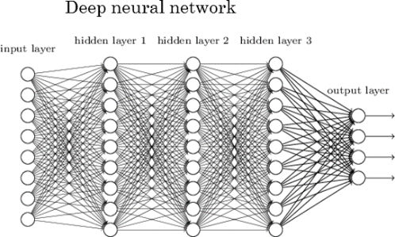
Deep Learning Neural Network
Image borrowed from:
http://www.kdnuggets.com/2017/05/deep-learning-big-deal.html

Slide 86
Terminology: Tensors
Tensor: A multi-dimensional array
Example: A sequence of images can be represented as a 4-D array: [image_num, row, col, color_channel]
Px_value[1, 1, 3, 2]=1
Image #0
Image #1

Slide 87
Terminology: Computational Graphs
Computational graphs help to break down computations.
For example, the graph for y=(x1+x2)*(x2 - 5) is
x1
a = x1 + x2
The beauty of computational graphs is that they show where computations can be done in parallel.
y = a*b
x2
b = x2 - 5

Slide 88
The need for GPUs
With deep learning models, you can have hundreds of thousands of computational graphs.
A GPU has the ability to perform a thousand or more of the computational graphs simultaneously. This will speed up your program significantly.
Note: Most algorithms can run without GPUs, but they will be slower.

Slide 89
Coding a Tensor Flow

Slide 90
Coding Tensor Flow: General Steps
Load the neural network packages
Read in the data
Divide the data into a training set and a test set.
Preprocess the data
Design the Network Model
Train the model
Apply the model to the test data
Display the results

Slide 91
1. Load Keras Packages
from tensorflow import keras
from tensorflow.keras import layers
from tensorflow.keras.utils import to_categorical

Slide 92
2. Read in the Data
import numpy as np
data_file = 'Data/cancer_data.csv'
target_file = 'Data/cancer_target.csv'
cancer_data=np.loadtxt(data_file,dtype=float,
delimiter=',')
cancer_target=np.loadtxt(target_file, dtype=float, delimiter=',')

Slide 93
3. Split the Data
from sklearn import model_selection
test_size = 0.30
seed = 7
train_data, test_data, train_target, test_target = model_selection.train_test_split(cancer_data,cancer_target, test_size=test_size,
random_state=seed)

Slide 94
4. Pre-process the Data
from sklearn.preprocessing import StandardScaler
scaler = StandardScaler()
# Fit only to the training data
scaler.fit(train_data)
# Now apply the transformations to the data:
x_train = scaler.transform(train_data)
x_test = scaler.transform(test_data)
# Convert the classes to ‘one-hot’ vector
y_train = to_categorical(train_target, num_classes=2)
y_test = to_categorical(test_target, num_classes=2)

Slide 95
5. Define the Model
def define_model():
from tensorflow.keras.models import Sequential
from tensorflow.keras.layers import Dense, Dropout
from tensorflow.keras.optimizers import SGD
model = keras.Sequential([
layers.Dense(30, activation="relu"),
layers.Dropout(0.5),
layers.Dense(60, activation="relu"),
layers.Dropout(0.5),
layers.Dense(2, activation="softmax")
])
model.compile(optimizer="rmsprop",
loss="binary_crossentropy",
metrics=["accuracy"]
)
return(model)
model = define_model()

Slide 96
7. Fit the Model
b_size = int(.8*x_train.shape[0])
num_epochs = 20
model.fit(x_train, y_train, epochs=num_epochs, batch_size=b_size)

Slide 97
8. Apply the Model to Test Data
predictions = np.argmax(model.predict(x_test), axis=-1)

Slide 98
9. Evaluate the Results
score = model.evaluate(x_test, y_test, batch_size=b_size)
print('\nAccuracy: %.3f' % score[1])
from sklearn.metrics import confusion_matrix
print(confusion_matrix(test_target, predictions))

Slide 99
Activity: TensorFlow Program
Make sure that you can run the TensorFlow code:
Python
04_TensorFlow.ipynb

Slide 100
PyTorch

Slide 101
What is PyTorch?
Another interface for example of TensorFlow.
A software library, developed by Facebook and maintained by Mega AI.

Slide 102
Overview of PyTorch
Because PyTorch uses Tensorflow as the underlying code, many of the required functions (e.g., activation, loss, optimizer) will be the same.

Slide 103
Activation Function
A function that will be determine if a node should “fire”.
Examples include nn.ReLU, nn.Sigmoid, and nn.Softmax.
A complete list is available at
https://pytorch.org/docs/stable/nn.html#non-linear-activations-weighted-sum-nonlinearity
and
https://pytorch.org/docs/stable/nn.html#non-linear-activations-other

Slide 104
Loss Function
A function that will be optimized to improve the performance of the model.
Examples include nn.BCELoss (Binary CrossEntropy) and nn.CrossEntropyLoss.
A complete list is available at https://pytorch.org/docs/stable/nn.html#loss-functions

Slide 105
Optimizer functions
The function for tweaking the weights.
Examples include SGD, Adam, and RMSprop.
A complete list is available at https://pytorch.org/docs/stable/optim.html?highlight=optimizer#torch.optim.Optimizer

Slide 106
Coding a PyTorch Example

Slide 107
Coding Tensor Flow: General Steps
Import the torch package
Read in the data
Preprocess the data
3a. Scale the data
3b. Split the data
3c. Convert data to tensors
3d. Load the tensors
Design the Network Model
Define the Learning Process
Train the model
Apply the model to the test data
Display the results

Slide 108
1. Import torch Package
import torch
if torch.cuda.is_available():
device_type = "cuda:" +
str(torch.cuda.current_device())
else:
device_type = "cpu"
device = torch.device(device_type)

Slide 109
2. Read in the Data
import numpy as np
data_file = 'Data/cancer_data.csv'
target_file = 'Data/cancer_target.csv'
x=np.loadtxt(data_file,dtype=float,delimiter=',')
y=np.loadtxt(target_file, dtype=float, delimiter=',')
print("shape of x: {}\nshape of y: {}".format(x.shape,y.shape))

Slide 110
3a. Scale the data
#feature scaling
from sklearn.preprocessing import StandardScaler
sc = StandardScaler()
x = sc.fit_transform(x)

Slide 111
3b. Split the Data
from sklearn import model_selection
test_size = 0.30
seed = 7
train_data, test_data, train_target, test_target = model_selection.train_test_split(x, y, test_size=test_size, random_state=seed)

Slide 112
3c. Convert data to tensors
#defining dataset class
from torch.utils.data import Dataset
class dataset(Dataset):
def __init__(self,x,y):
self.x = torch.tensor(x,dtype=torch.float32)
self.y = torch.tensor(y,dtype=torch.float32)
self.length = self.x.shape[0]
def __getitem__(self,idx):
return self.x[idx],self.y[idx]
def __len__(self):
return self.length
trainset = dataset(train_data,train_target)

Slide 113
3d. Load the tensors
#DataLoader
from torch.utils.data import DataLoader
trainloader = DataLoader(trainset,batch_size=64,shuffle=False)

Slide 114
4. Design the Network Model
from torch import nn
class Net(nn.Module):
def __init__(self,input_shape):
super(Net,self).__init__()
self.fc1 = nn.Linear(input_shape,32)
self.fc2 = nn.Linear(32,64)
self.fc3 = nn.Linear(64,1)
def forward(self,x):
x = torch.relu(self.fc1(x))
x = torch.relu(self.fc2(x))
x = torch.sigmoid(self.fc3(x))
return x
model = Net(input_shape=x.shape[1])

Slide 115
5. Define the Learning Process
learning_rate = 0.01
epochs = 700
optimizer = torch.optim.SGD(model.parameters(),
lr=learning_rate)
loss_fn = nn.BCELoss()

Slide 116
6. Fit the Model
losses = []
accur = []
for i in range(epochs):
for j,(x_train,y_train) in enumerate(trainloader):
#calculate output
output = model(x_train)
#calculate loss
loss = loss_fn(output,y_train.reshape(-1,1))
#accuracy
predicted = model(torch.tensor(x,dtype=torch.float32))
acc = (predicted.reshape(-1).detach().numpy().round() == y).mean()
#backprop
optimizer.zero_grad()
loss.backward()
optimizer.step()
if i%50 == 0:
losses.append(loss)
accur.append(acc)
print("epoch {}\tloss : {}\t accuracy : {}".format(i,loss,acc))

Slide 117
7. Apply the Model to Test Data
testset = dataset(test_data,test_target)
trainloader = DataLoader(testset,batch_size=64,shuffle=False)
predicted = model(torch.tensor(test_data,dtype=torch.float32))

Slide 118
8. Evaluate the Results
acc = (predicted.reshape(-1).detach().numpy().round() == test_target).mean()
print('\nAccuracy: %.3f' % acc)
from sklearn.metrics import confusion_matrix
predicted = predicted.reshape(-1).detach().numpy().round()
print(confusion_matrix(test_target, predicted))

Slide 119
Activity: PyTorch Program
Make sure that you can run the PyTorch code:
Python
06_PyTorch.ipynb

Slide 120
Break
We will return in 15 minutes.

Slide 121
Multi-GPU Example

Slide 122
Activity: Multi-GPU Program
Before running the next notebook, you will need to create a new JupyterLab session and request 2 GPUs rather than 1.
Python
07_Tensorflow_Parallel.ipynb

Slide 123
Need more help?
Office Hours via Zoom
Tuesdays: 3 pm - 5 pm
Thursdays: 10 am - noon
Zoom Links are available at https://www.rc.virginia.edu/support/#office-hours
Website:
https://rc.virginia.edu

Slide 124
Questions?

Slide 125
Supplemental Material
Convolutional Neural Networks

Slide 126
Convolutional Neural Networks

Slide 127
What are Convolutional Neural Networks?
Originally, convolutional neural networks (CNNs) were a technique for analyzing images.
CNNs apply multiple neural networks to subsets of a whole image in order to identify parts of the image.
Applications have expanded to include analysis of text, video, and audio.

Slide 128
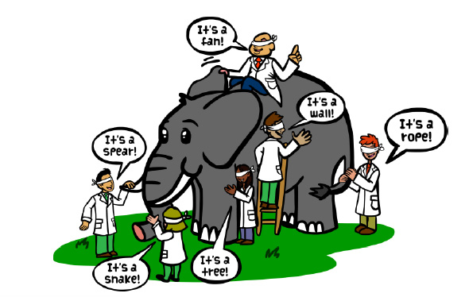
The Idea behind CNN
Recall the old joke about the blind-folded scientists trying to identify an elephant.
A CNN works in a similar way. It breaks an image down into smaller parts and tests whether these parts match known parts.
It also needs to check if specific parts are within certain proximities.
For example, the tusks are near the trunk and not near the tail.
Image borrowed from https://tekrighter.wordpress.com/2014/03/13/metabolomics-elephants-and-blind-men/

Slide 129
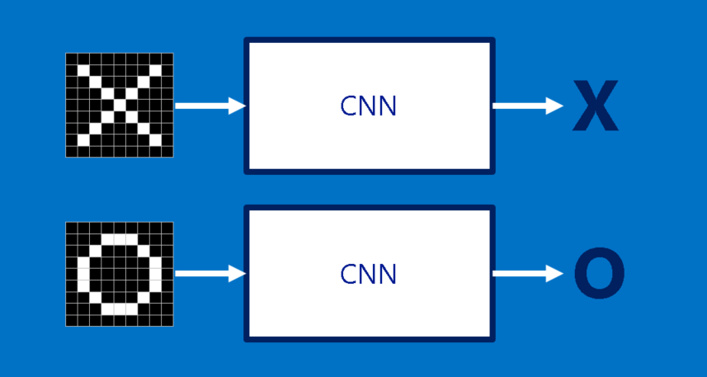
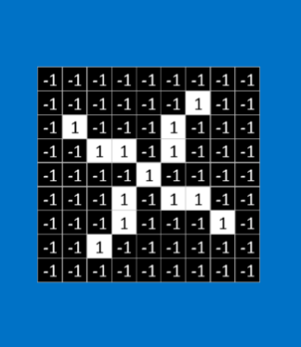
Is the image on the left most like an X or an O?
Images borrowed from
http://brohrer.github.io/how_convolutional_neural_networks_work.html

Slide 130
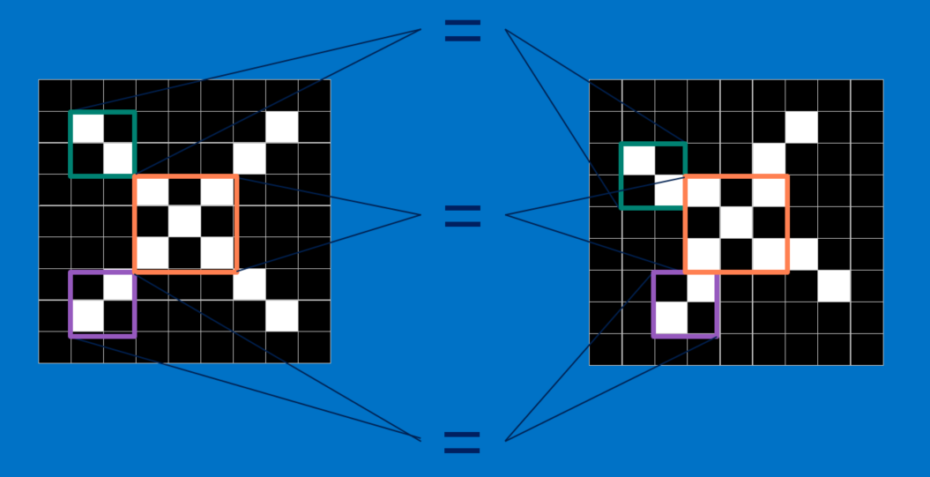
What features are in common?

Slide 131
Building Blocks of CNN
CNN performs a combination of layers
Convolution Layer
Compares a feature with all subsets of the image
Creates a map showing where the comparable features occur
Rectified Linear Units (ReLU) Layer
Goes through the features maps and replaces negative values with 0
Pooling Layer
Reduces the size of the rectified feature maps by taking the maximum value of a subset
And, ends with a final layer
Classification (Fully-connected layer) layer
Combines the specific features to determine the classification of the image

Slide 132
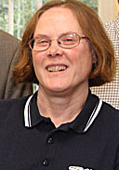
Steps
.
.
.
Convolution Rectified Linear Pooling
These layer can be repeated multiple times.
The final layer converts the final feature map to the classification.
{

Slide 133
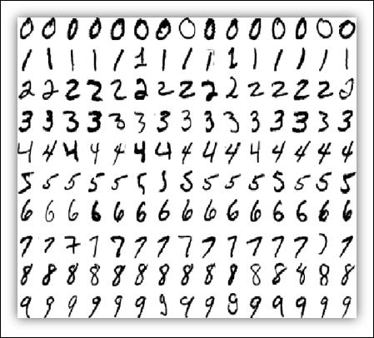
Example: MNIST Data
The MNIST data set is a collection of hand-written digits (e.g., 0 – 9).
Each digit is captured as an image with 28x28 pixels.
The data set is already partitioned into a training set (60,000 images) and a test set (10,000 images).
The tensorflow packages have tools for reading in the MNIST datasets.
More details on the data are available at http://yann.lecun.com/exdb/mnist/
Image borrowed from
Getting Started with TensorFlow by Giancarlo Zaccone

Slide 134
Coding CNN: General Steps
Load the data
Preprocess the data.
2a. Capture the sizes
2b. Reshape the data
Design the Network Model
Train the model
Apply the model to the test data
Display the results

Slide 135
1. Load the Data
(X_train, Y_train), (X_test, Y_test) = mnist.load_data()

Slide 136
2a. Pre-process the Data: Capture the sizes
numTrain = train_images.shape[0]
numTest = test_images.shape[0]
image_width = train_images.shape[1]
image_height = train_images.shape[2]
image_channels = 1

Slide 137
2b. Pre-process the Data: Reshape
train_images = train_images.reshape((numTrain, image_height, image_width, image_channels))
train_images = train_images.astype("float32") / 255
test_images = test_images.reshape((numTest, image_height, image_width, image_channels))
test_images = test_images.astype("float32") / 255

Slide 138
3. Design the Network model: Part 1/4
def define_model(image_shape):
from tensorflow import keras
from tensorflow.keras import layers
image_width = image_shape[2]
image_height = image_shape[1]
image_channels = image_shape[3]
#Define the input shape
inputs = keras.Input(shape=(image_height, image_width, image_channels))

Slide 139
3. Design the Network model: Part 2/4
#Define the hidden layers to be applied to the inputs & subsequent layers
x = layers.Conv2D(filters=32, kernel_size=3, activation="relu")(inputs)
x = layers.MaxPooling2D(pool_size=2)(x)
x = layers.Conv2D(filters=64, kernel_size=3, activation="relu")(x)
x = layers.MaxPooling2D(pool_size=2)(x)
x = layers.Conv2D(filters=128, kernel_size=3, activation="relu")(x)
x = layers.Flatten()(x)

Slide 140
3. Design the Network model: Part 3/4
#Define the output layer
outputs = layers.Dense(10, activation="softmax")(x)
model = keras.Model(inputs=inputs, outputs=outputs)
model.compile(optimizer="rmsprop",
loss="sparse_categorical_crossentropy",
metrics=["accuracy"])
return(model)

Slide 141
3. Design the Network model: Part 4/4
image_shape = train_images.shape
model = define_model(image_shape)

Slide 142
4. Train the model
num_epochs = 5
batch_size = 64
model.fit(train_images, train_labels, epochs=num_epochs, batch_size=batch_size)

Slide 143
5. Apply Model to Test Data
test_loss, test_acc = model.evaluate(test_images, test_labels)

Slide 144
Display the results
print(f"Test accuracy: {test_acc:.3f}")

Slide 145
Activity: CNN Program
Make sure that you can run the CNN code:
Python
05_CNN.ipynb

